Slide 1






Sugarbowl CGM Analyzer
Glycemic Increment
JEN BALASI
LA MONTE YARROLL
2025-09-14
Notes:
LeMonte

Slide 2
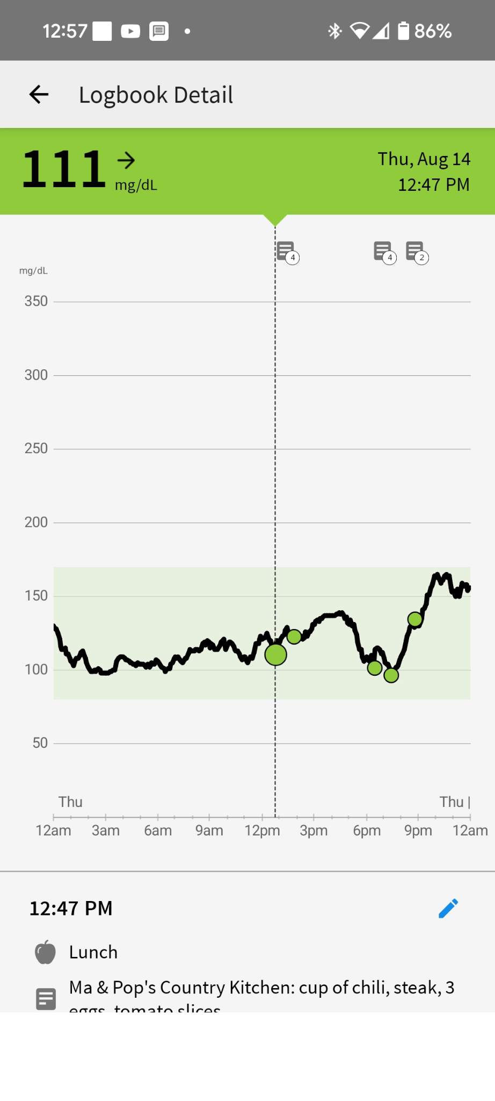
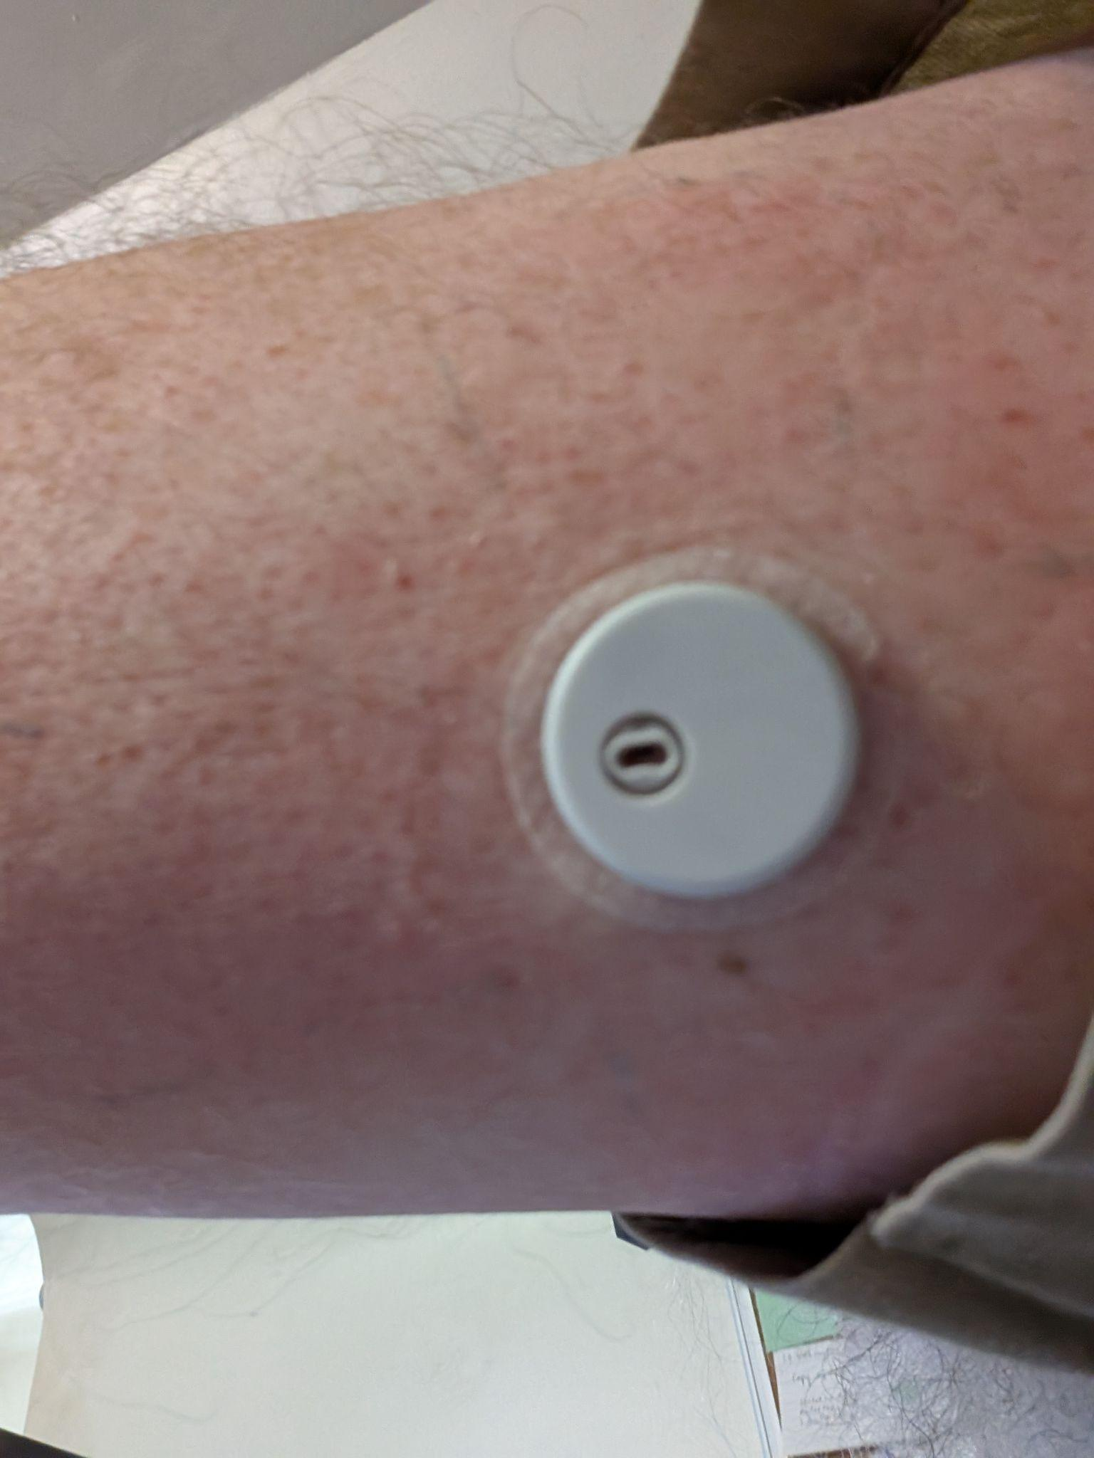
What is a Continuous Glucose Monitor?

Slide 3
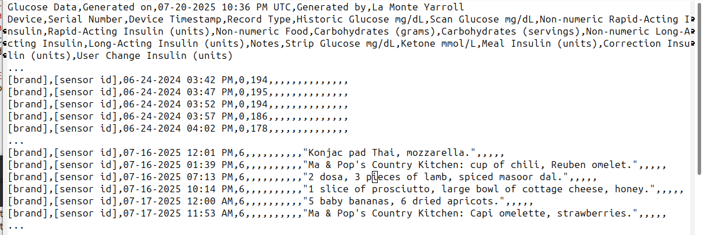
Dataset
Our dataset is a near-continuous record of glucose levels every 5 minutes for 2 years, along with free-form text descriptions of most of the meals.

Slide 4
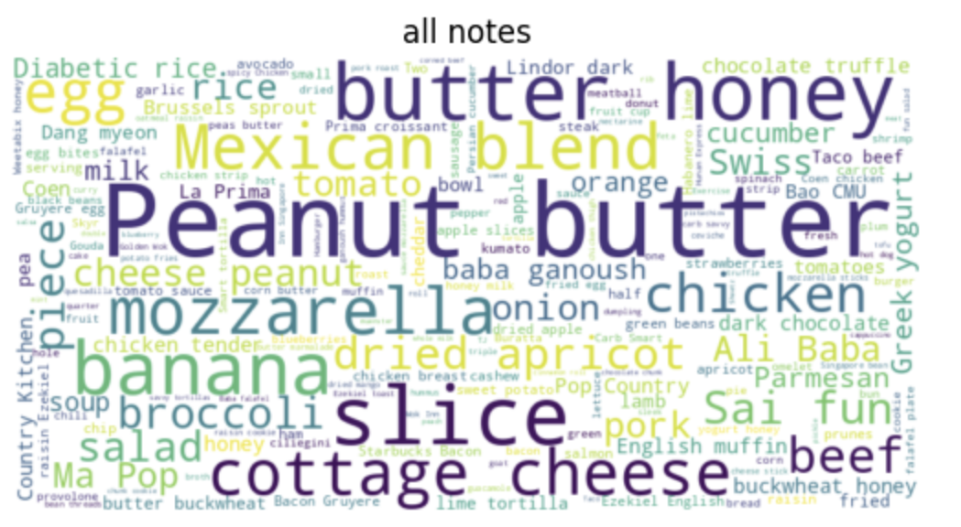
Initial Exploration EDA

Slide 5
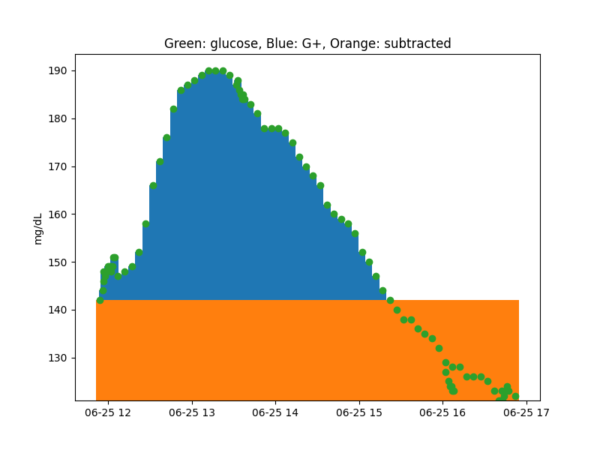
Glycemic Increment
Glycemic Increment (G+) is new for our study. It’s the area under the glucose curve for the duration of the measurement period, minus the starting glucose, standardized to 1 hour. The unit is mg-hours/dL.

Slide 6
Derived datasets: Meals
Regular meals (every note is a meal)
  Total meals: 1874
  Duration: 2 hours from note
Extended meals (close notes make a meal)
  Total meals: 1071
  Close: < 2 hours
  Duration: time of first note to 2 hours past last note
Unpreceeded meals (no recent note)
  Total meals: 889
  Fasting: > 4 hours
  Duration: 30 minutes from note

Slide 7
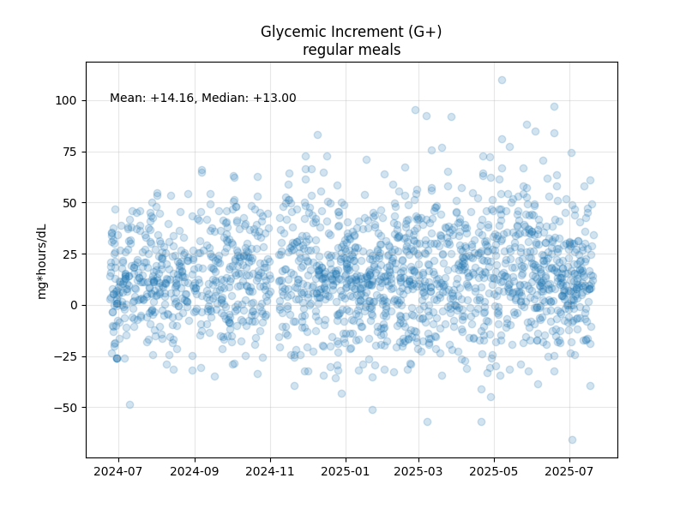
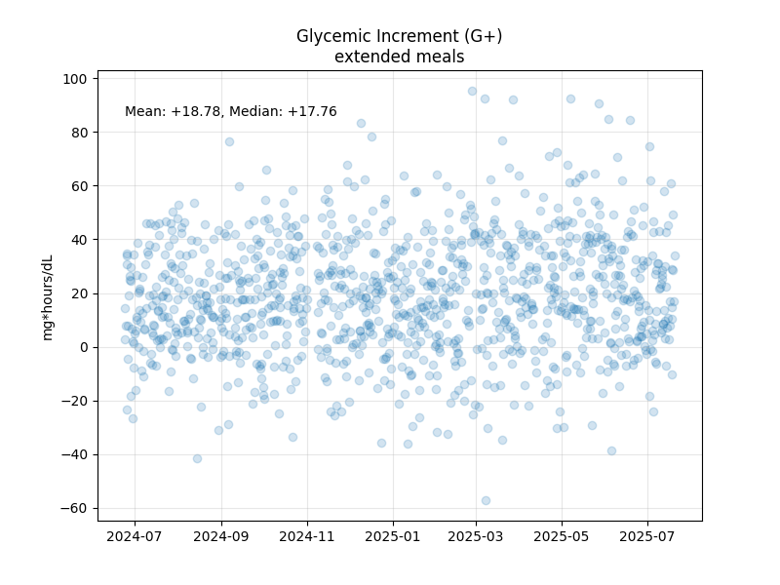
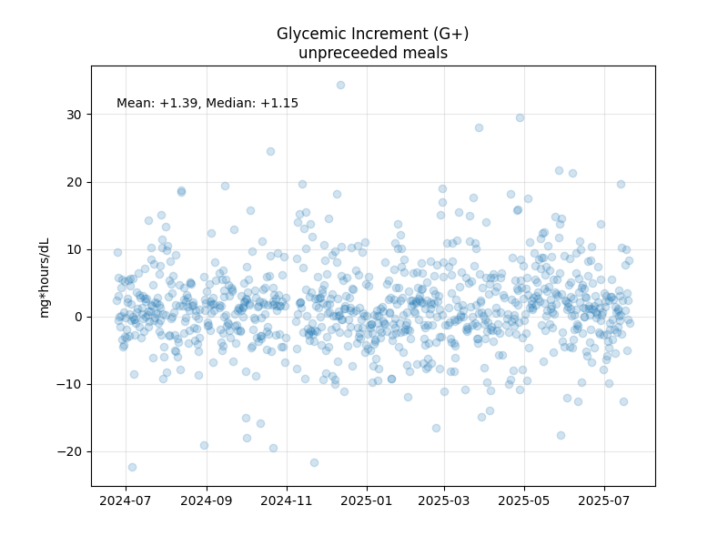
Derived datasets: Meals

Slide 8
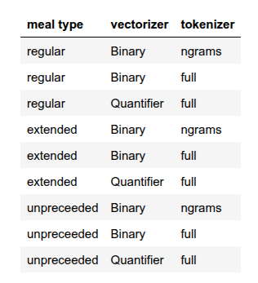
Models
Tokenizer
  CountVectorizer’s ngram_range=(1,3)
  Full Token (Restaurant Name: food1 no bun, 2 servings of food2.)
Vectorizer
  CountVectorizer binary
  QuantifierVectorizer (Uses full token parser)

Slide 9
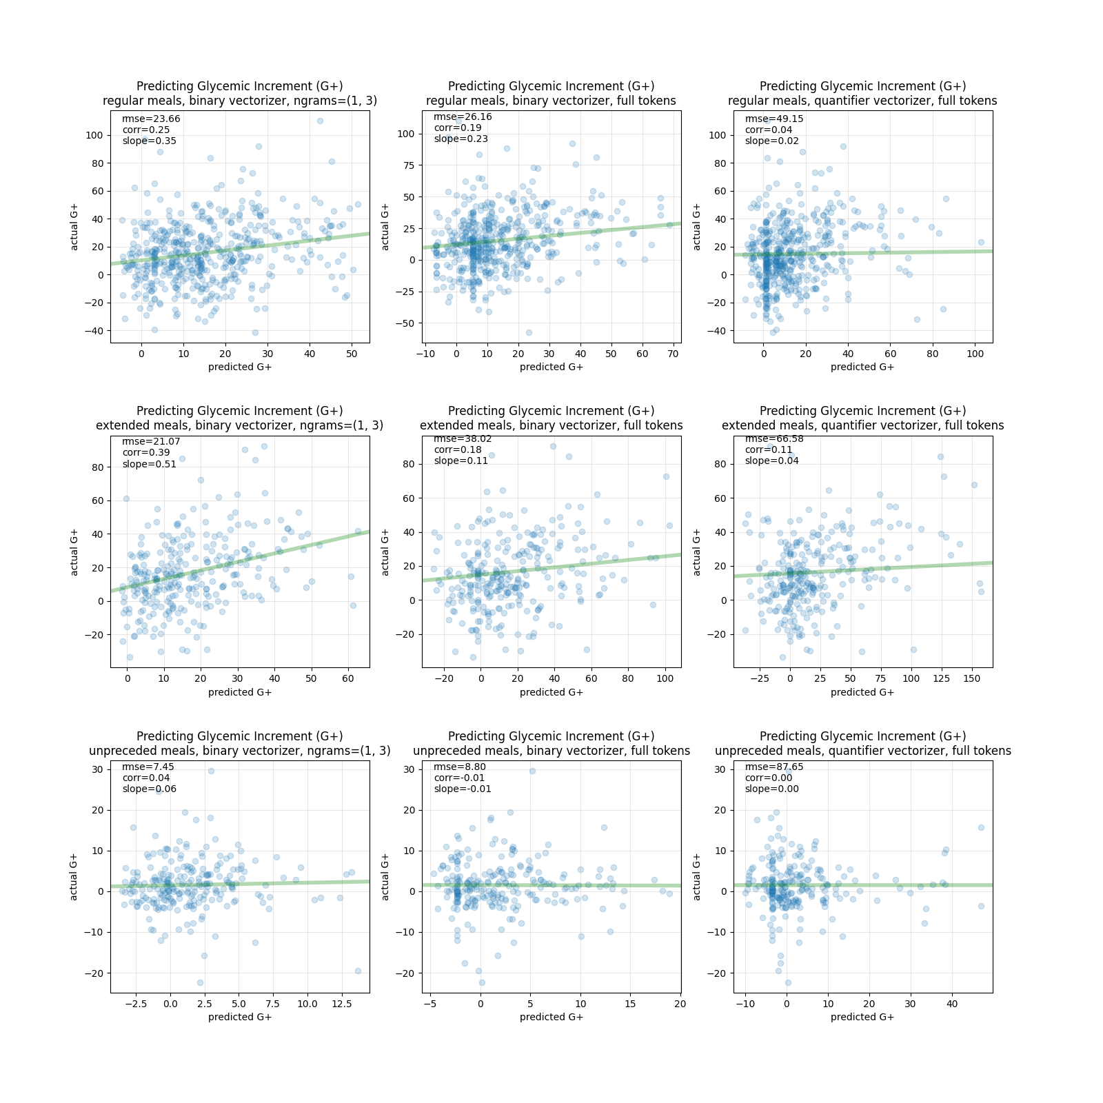
Models on Test Sets
bin, ngram bin, full quant, full
regular meals
extended meals
unpreceded meals

Slide 10
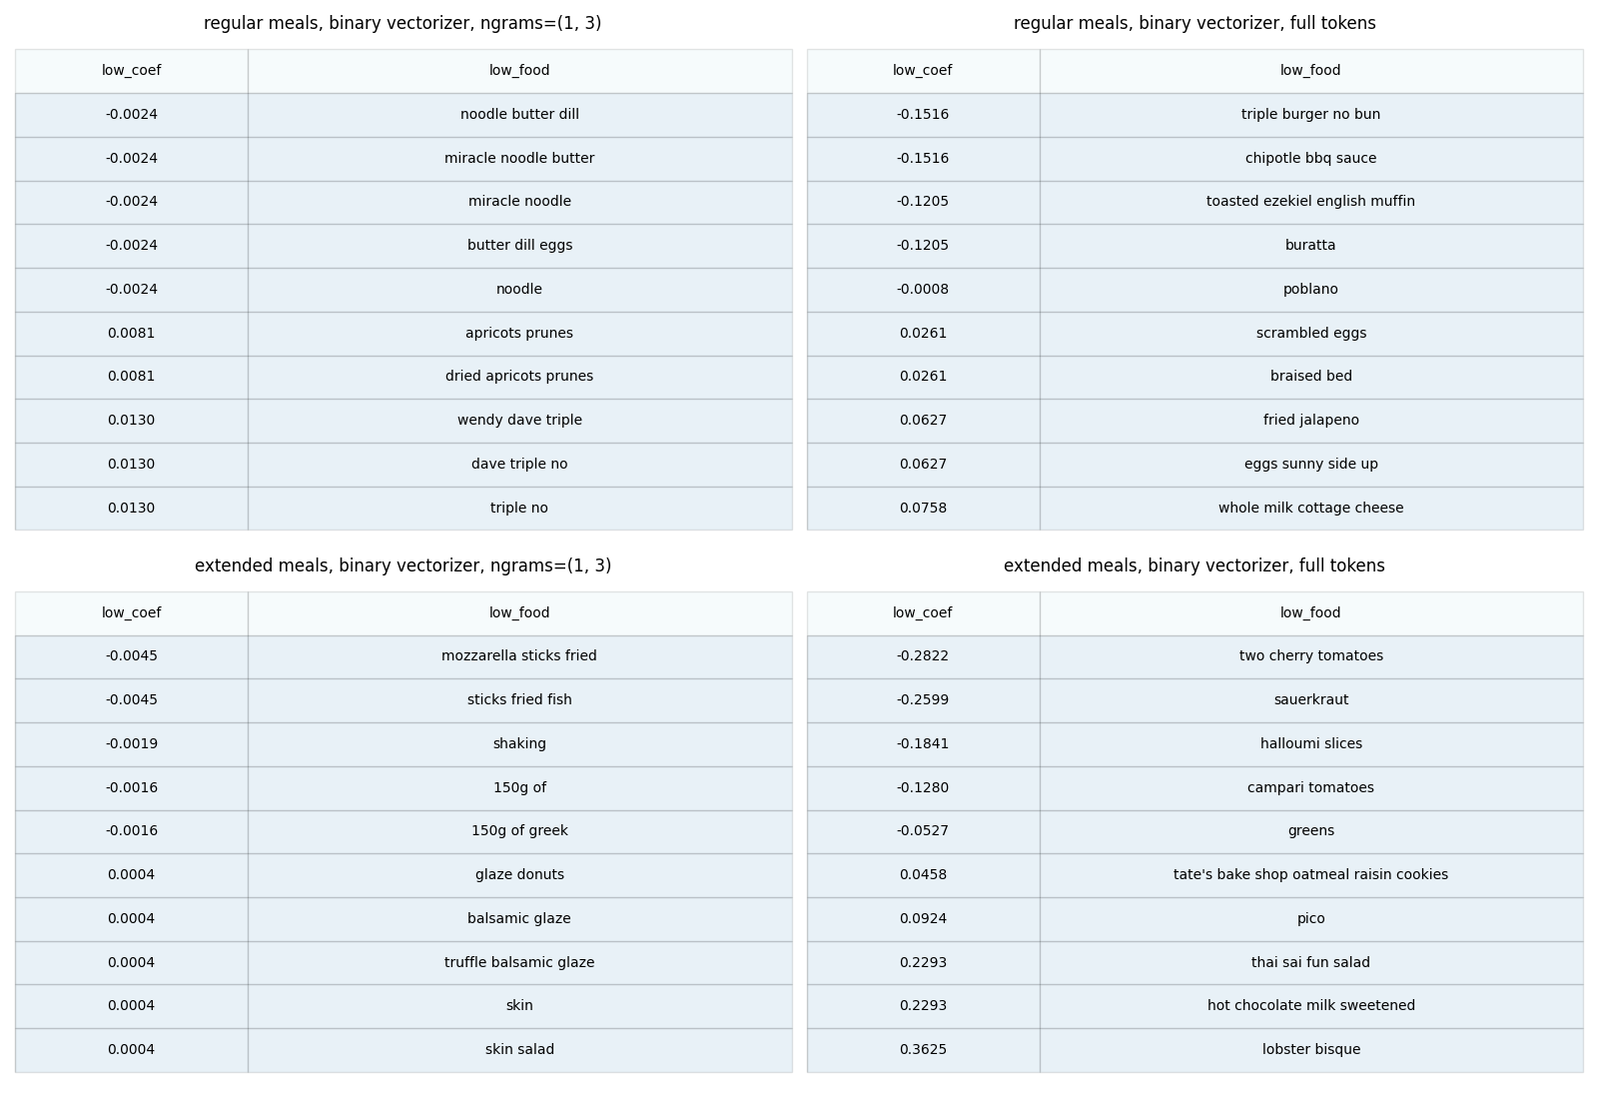
Low score foods (eat these)

Slide 11
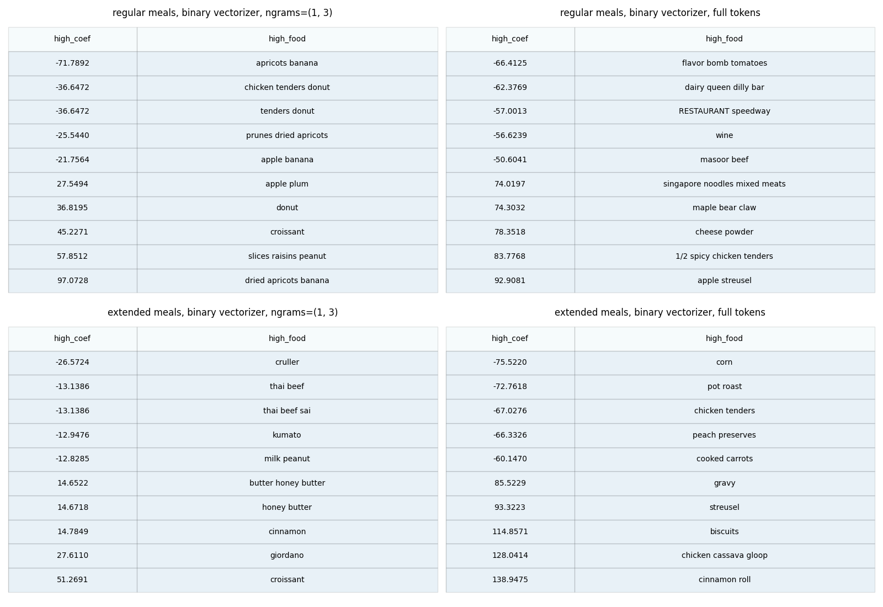
Extreme score foods (avoid these)

Slide 12

Questions?

Slide 13
Standard Glycemic Measures
Glycemic Index (GI) is a measure of how quickly 50g of carbohydrates from a particular food are absorbed over 2 hours, normalized against 50g of pure glucose.
Glycemic Load (GL) is a measure of how quickly a typical serving of a particular food will affect glucose levels over the next 2 hours. It is GI * carbs in a serving / 100.

Slide 14
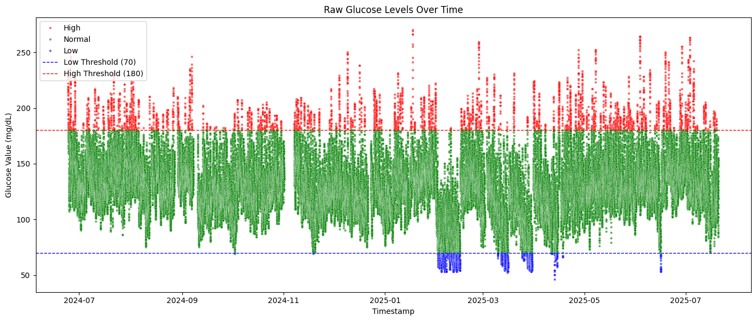
ADA Target Levels for Blood Glucose
Notes:
This is all of the data points over time showing in what range the reading fell. Less than 70 is considered low, higher than 180 is considered too high. We need to keep the glucose levels in the green.

Slide 15
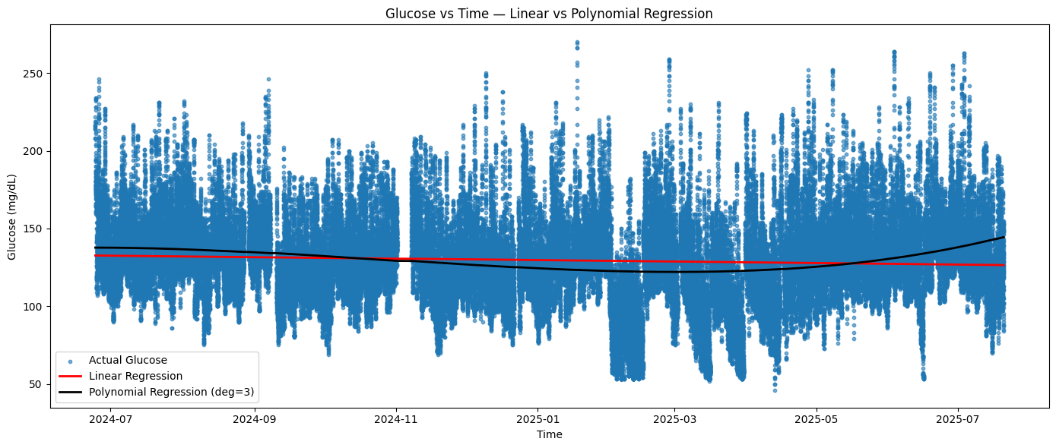
Glucose over time regressed
Notes:
This is all of the data points over time showing in what range the reading fell. Less than 70 is considered low, higher than 180 is considered too high. We need to keep the glucose levels in the green.

